Slide 1


Slide 2

Product Release
PRESENTATION
GROUP 4 | Machine Learning, Robotics And Sensor Networks Summer School
08/2018
Notes:
Good afternoon everyone. Here our team will introduce our project-the robot feedie.

Slide 3
WHAT
IS
FEEDIE
?
Notes:
the robot is designed to help the unabled catch food, such as bread or water.

Slide 4
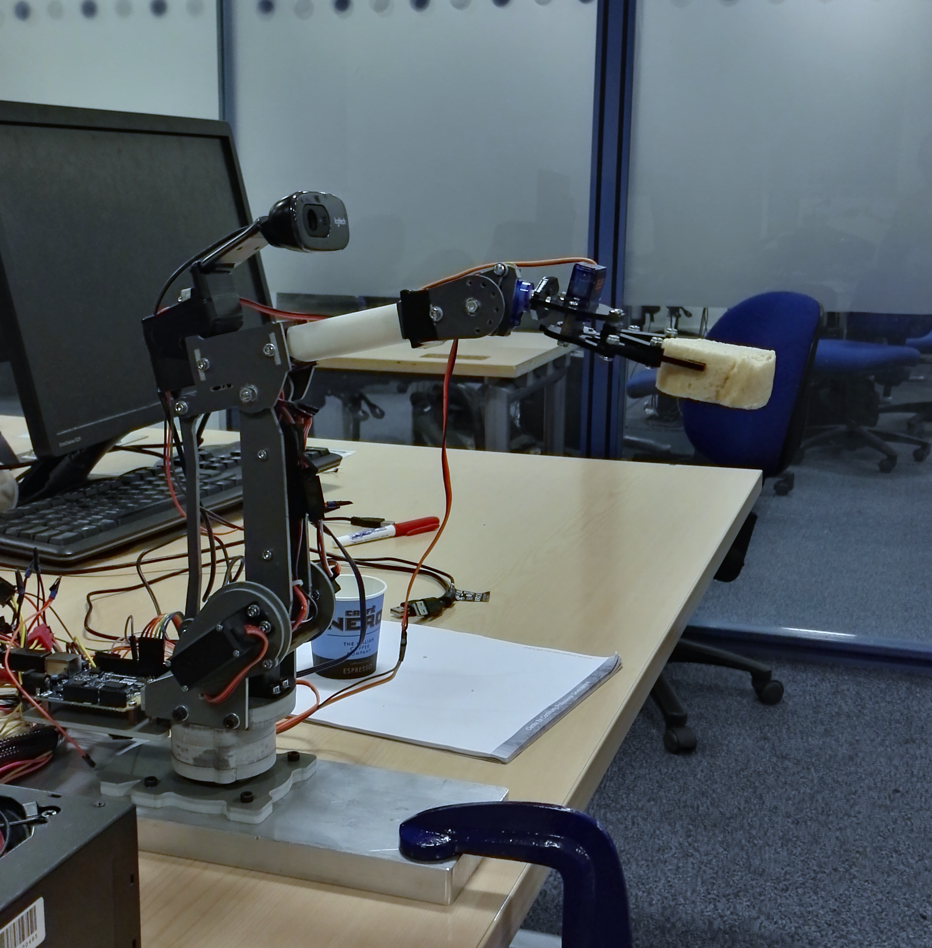
WHAT IS FEEDIE ?
FEEDIE is designed aiming at the group of people
who are unable to eat or drink independently.
The user can control FEEDIE
to fetch them food or drink by oral instructions.
Notes:
the robot is designed to help the unabled catch food, such as bread or water.

Slide 5
WHAT IS FEEDIE ?
FEEDIE is designed aiming at the group of people who are unable to eat independently. The user can control FEEDIE to fetch them food or drink by oral instructions.
I FEED U EAT

Slide 6
WHAT IS FEEDIE ?
FEEDIE is designed aiming at the group of people who are unable to eat independently. The user can control FEEDIE to fetch them food by oral instructions.
FEEDIE
START

Slide 7

CONTENT
Ⅰ
Ⅱ
INTRO
CORE TECHNIQUE
Ⅲ
Ⅳ
BUSINESS
POTENTIAL
TEAMWORK
GROUP 4 | Machine Learning, Robotics And Sensor Networks Summer School
08/2018
Notes:
There are four parts. So first let’s welcome LY, our chief programmer.

Slide 8
PART 2
CORE TECHNIQUE
Ⅱ
GROUP 4 | Machine Learning, Robotics And Sensor Networks Summer School
08/2018

Slide 9
Module Analysis

Slide 10
PART 2 CORE TECHNIQUE
Module Analysis
FEEDIE
Hardware
Robotic Arm, Arduino 101, Power Supply .etc.
Software
Front-End
Background
HCI
Speech Recognition
Image Recognition
Real-time
Video
GROUP 4 | Machine Learning, Robotics And Sensor Networks Summer School
08/2018
Notes:
Here are the main modules of our project.
As He Yuxuan said just now, our robot is designed for people who couldn’t eat independently, so our robot ought to be automatic. Therefore, we came out the idea of controlling the robot by oral instructions

Slide 11
PART 2 CORE TECHNIQUE
Existing APIs
✘couldn’t response in time
↓
GMM-HMM & random forest
✘could only classify some specific instructions
↓
An offline framework
& a natural language processing model
✓could extract keywords from natural language
Module Analysis
SPEECH
RECOGNITION
GROUP 4 | Machine Learning, Robotics And Sensor Networks Summer School
08/2018
Notes:
At the beginning, we tried some existing APIs including Google and Baidu, but due to the quality of internet connection, these APIs couldn’t response in time.
Then we turned to train the speech recognition model by ourselves, we tried 2 algorithms including GMM-HMM model and Random forest to do the voice classification. The result was quite good but the model could only classify some specific instructions. So we then turned back to a combination of an offline third-party speech recognition framework and a Natural Language Processing Model. Now this module could not only deal with simple commands but also extract key words from natural language.
After receiving instructions from user, our robot will turn to the desktop to search for what the user want, which requires image recognition.

Slide 12
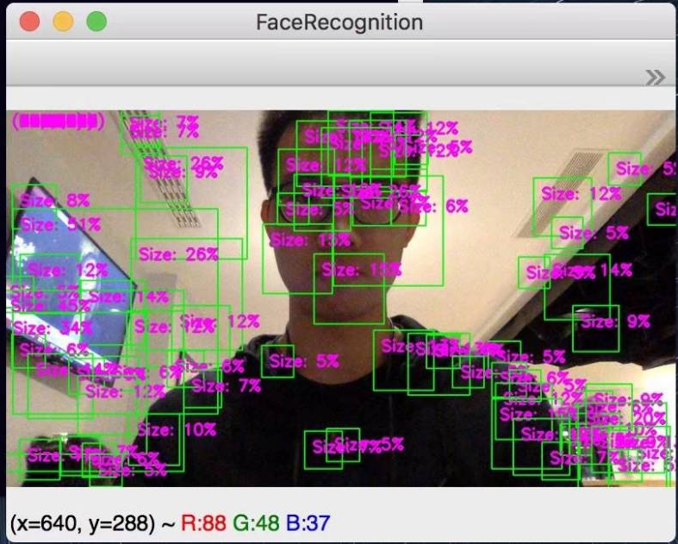
PART 2 CORE TECHNIQUE
Opencv Classifier
✘couldn’t work very well
↓
CNN framework
✘hard to track the object
Module Analysis
IMAGE
RECOGNITION
GROUP 4 | Machine Learning, Robotics And Sensor Networks Summer School
08/2018
Notes:
In order to find the specific object, 3 methods were used to do the work. Firstly, we trained a mouth classifier by ourselves and imported it into opencv to detect the user’s mouth, but this is our result.
As you see, the classifier couldn’t work very well, so we tried another method, the CNN framework. It did do the classification very well but it was hard to track the object with this framework.
Finally, we found that we used wrong parameters and lack training samples to do the training at the very beginning, so we turned back to train the opencv classifier with 1900 positive samples and 4500 negative samples, this time the result seem to be much better.

Slide 13
PART 2 CORE TECHNIQUE
Opencv Classifier
1900 positive samples
4500 negative samples
10 layers
Module Analysis
IMAGE
RECOGNITION
the feedback mechanism of misjudgment
Reinforcement learning
GROUP 4 | Machine Learning, Robotics And Sensor Networks Summer School
08/2018
Notes:
Finally, we found that we used wrong parameters and lack training samples to do the training at the very beginning, so we turned back to train the opencv classifier with 1900 positive samples and 4500 negative samples, this time the result seem to be much better.
Besides, We added the feedback mechanism of misjudgment into our system and applied the idea of Reinforcement learning

Slide 14
PART 2 CORE TECHNIQUE
Module Analysis
IMAGE
RECOGNITION
GROUP 4 | Machine Learning, Robotics And Sensor Networks Summer School
08/2018
Notes:
After detecting the food on the table, the robot arm should be changing its gesture to grab the food. Prof Yang said 3 weeks ago that it is important to keep the food balanced when carrying it to the user, so we designed an special algorithm to make it.

Slide 15
PART 2 CORE TECHNIQUE
Module Analysis
FEEDIE
Hardware
Robotic Arm, Arduino 101, Power Supply .etc.
Software
Front-End
Background
HCI
Speech Recognition
Image Recognition
Real-time
Video
GROUP 4 | Machine Learning, Robotics And Sensor Networks Summer School
08/2018
Notes:
Now the system can work. But as we all know, a mature system must have a close loop. So we constructed a web framework to do the multiprocessing(speech recognition and image recognition simultaneously) at the background and show real-time video at the front end.

Slide 16
PART 2 CORE TECHNIQUE
Module Analysis
FEEDIE
Front-End
Background
HCI
Speech
Recognition
Image
Recognition
Real-time
Video
Softwre
GROUP 4 | Machine Learning, Robotics And Sensor Networks Summer School
08/2018
Notes:
Now the system can work. But as we all know, a mature system must have a close loop. So we constructed a web framework to do the multiprocessing(speech recognition and image recognition simultaneously) at the background and show real-time video at the front end.

Slide 17
PART 2 CORE TECHNIQUE
Module Analysis
Accuracy
Robustness
High
Efficiency
GROUP 4 | Machine Learning, Robotics And Sensor Networks Summer School
08/2018
Notes:
All our modules work together to realize the accuracy, robustness and high efficiency of our system.

Slide 18
PLENTIFUL IN IDEAL YET SKINNY IN REALITY
…
Notes:
Apparently, we had relatively high expectation for FEEDIE, so we had to face a series of obstacles, which taught us precious lessons

Slide 19
Problems And Solutions
Before: running for 30 hours by using the existing tool
Solution: recompiled the program, changed mononuclear into multinuclear
Be Creative
The complexity of training model: 1900 positive samples, 4500 negative samples, 10 layers
Notes:
First we learned to be creative. For example, we had to train 1900 positive samples and 4500 negative samples with 10 layers, at first it took us 30 hours. So we came up with the idea of changing mononuclear into multinuclear. This method Saved us much time.

Slide 20
Before: used Baidu online speech recognition, required long time
Try: used GMM classifier to do the instruction classification, the outcome was unsatisfying
Solution: used Apple input method instead.
Learn to give up and simplify problems
Speech recognition
Notes:
Then, we learned to give up and simplify problems. To realize speech recognition, the first method took a long time to recognize speech. So we used some advanced approaches but they didn’t work well. Finally we adopted a simple solution which brought us a great outcome.

Slide 21
Face the difficulty bravely
To keep the cup balanced:
Worked out an algorithm step by step
Notes:
Next, faced with the task of keeping the cup balanced, which seemed very hard. But we eventually made it.

Slide 22
Keep calm and
make the most of the resources at hand
Hardware: the board, power and motors burned a few days before presentation
Solution: bought a multimeter to debug
found an extra mechanical arm and used its components to reassemble our arm
Notes:
Last, a few days before presentation, the mechanical arm broke down suddenly, which was a disaster. Luckily we found the teacher’s mechanical arm so we took it apart and reassembled ours.

Slide 23
PART 3
BUSINESS POTENTIAL
GROUP 4 | Machine Learning, Robotics And Sensor Networks Summer School
08/2018

Slide 24
Market Prospect

Slide 25
PART 3 BUSINESS POTENTIAL
Market Prospect
SOCIAL BACKGROUND
In 2016, the number of people over the age of 60 in China was 230.86 million, accounting for 16.7% of the national population. It is expected to reach 300 million by 2025.
A large number of nursing workers are required to provide services to help and care for the elderly and the disabled.
2016
230.86 million
16.7%
300 million
By 2025
http://www.sohu.com/a/102388164_451068?qq-pf-to=pcqq.c2c
GROUP 4 | Machine Learning, Robotics And Sensor Networks Summer School
08/2018
Notes:
Before deciding what kind of robot we can offer, we need to know about what the market demands, this is what we have found:
from the data we can see China faces serious problems of aging population and a large number of nursing workers are in demand.

Slide 26
PART 3 BUSINESS POTENTIAL
Market Prospect
A feeding robot’s value:
For the other family members: Saves time
For the disabled: Convenience
For hospitals: saves human resources
VS the existing technology: Cheaper
VS care worker: economical
GROUP 4 | Machine Learning, Robotics And Sensor Networks Summer School
08/2018
Notes:
In this background,feeding robots are of much value, because
It Saves the time of the family to feed the user,
makes it easier for the disabled to eat food,
saves human resources in hospitals and nursing homes,
Also, it is cheaper than either hiring a care worker or using existing technology

Slide 27
PART 3 BUSINESS POTENTIAL
Market Prospect
Seize the opportunity
Survey Result （TOTAL: 157）
DIFFERENT OCCUPATIONS
DIFFERENT ECONOMIC STATUS
GROUP 4 | Machine Learning, Robotics And Sensor Networks Summer School
08/2018
Notes:
In order to estimate how acceptable FEEDIE is, we did a survey among different groups of people from different background:
PPT

Slide 28
Q2: Suppose that you or your family are not able to take care of your diet,
What do you think about a feeding robot fixed on the table?
SURVEY
Q1：Is there anyone in your
family who cannot take care of themselves?
GROUP 4 | Machine Learning, Robotics And Sensor Networks Summer School
08/2018
Notes:
From this survey we found that there is a large proportion of people whose family members need feeding help. So the conclusion is: FEEDIE has great market prospect.

Slide 29
Competitive Advantages

Slide 30
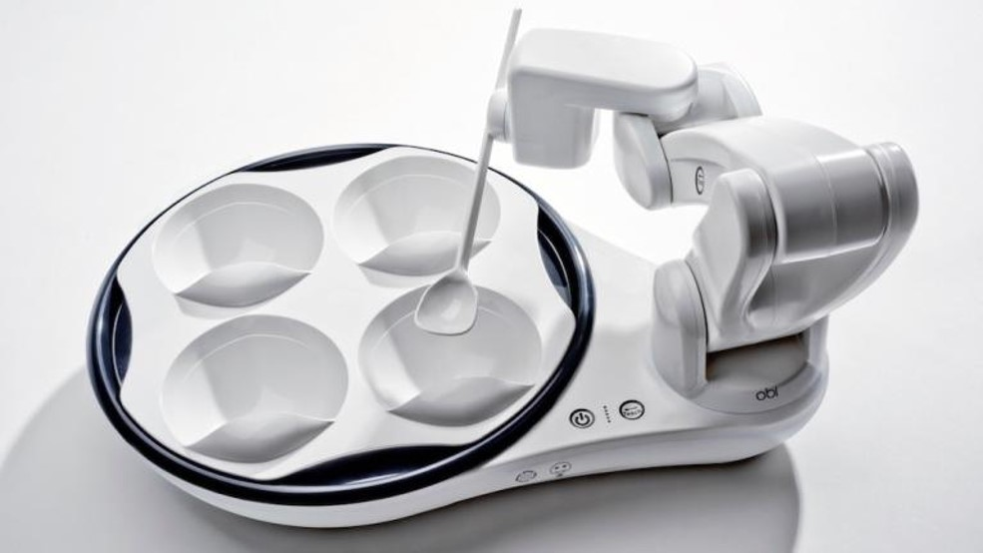
PART 3 BUSINESS POTENTIAL
Competitive Advantages
Competitors
OBI
A
STRENGTHS
Pioneer- the first feeding robot existing in the market
Simplification- simplify the model with the fixed plate and the easiest feeding tool (spoon)
B
WEAKNESSES
Lack of flexibility- cannot locate the position of the food and the user’s mouth automatically
Price- many families cannot afford this product
GROUP 4 | Machine Learning, Robotics And Sensor Networks Summer School
08/2018
Notes:
In the robot market we have to face fierce competitions, first we need to know the information about our competitor.
Obi,you can know about its information in our business plan
Here are its strengths and weaknesses. By analyzing these aspects we can make FEEDIE more competitive in the market.

Slide 31
PART 3 BUSINESS POTENTIAL
Competitive Advantages
Advantages of FEEDIE:
01
FEEDIE can recognize where the food( within its reach) is and reach it.
02
FEEDIE identify the user’s face and move the claw until it is in front of the mouth.
03
FEEDIE operates according to human’s oral order, realizing remote control.
GROUP 4 | Machine Learning, Robotics And Sensor Networks Summer School
08/2018
Notes:
FEEDIE has these advantages which its competitors don’t have, so we are confident that FEEDIE is a better choice.

Slide 32
Marketing Approach

Slide 33
PART 3 BUSINESS POTENTIAL
Marketing Approach
TARGET USERS
SALES CHANNELS
KEY PARTERNERS
disabled
Babies or elderly
Online
Offline
Electronic business platforms, such as Suning and Jing Dong in China and Amazon abroad.
Advertising companies.
Housekeeping companies.
…
TARGET CUSTOMERS
KEY ACTIVITIES
individuals: home care
businesses: hospital, nursing home
Membership system.
Trial services
After-sales services
Complementary products
and services
GROUP 4 | Machine Learning, Robotics And Sensor Networks Summer School
08/2018
Notes:
To increase profits, the high quality of our product is one aspect and the effective marketing approach is another
Based on the survey, we worked out five aspects of maket approaches
for the sake of time I won’t elaborate on these, you can see it in the business plan.

Slide 34
PART 3 BUSINESS POTENTIAL
Marketing Approach
KEY ACTIVITIES
Set up a membership system.
Provide trial services in specialty stores, hospitals, and nursing homes, attracting people to buy our products.
Provide high-quality after-sales services, including the three guarantees service, regular maintenance, feedback and so on.
Sale complementary products and services, such as customized nutrition recipes, matching tableware, etc.
GROUP 4 | Machine Learning, Robotics And Sensor Networks Summer School
08/2018

Slide 35
PART 3 BUSINESS POTENTIAL
Marketing Approach
KEY PARTERNERS
Electronic business platforms, such as Suning and Jing Dong in China and Amazon abroad.
Advertising companies.
Housekeeping companies.
…
GROUP 4 | Machine Learning, Robotics And Sensor Networks Summer School
08/2018

Slide 36
PART 4
TEAMWORK
GROUP 4 | Machine Learning, Robotics And Sensor Networks Summer School
08/2018

Slide 37
“Coming together is a beginning. Keeping together is progress.
Working together is success.”
------Henry Ford
WHAT MAKES A TEAM?
Information sharing
everyone makes a difference
Enjoy time together
Notes:
As you can see, so far we have basically achieved our goals: We overcame difficulties one after another and finally developed FEEDIE. Also worked out a detailed business plan according to the survey. We couldn’t make it without a great teamwork. Here I’d like to talk about how we worked as a team in three aspects.

Slide 38
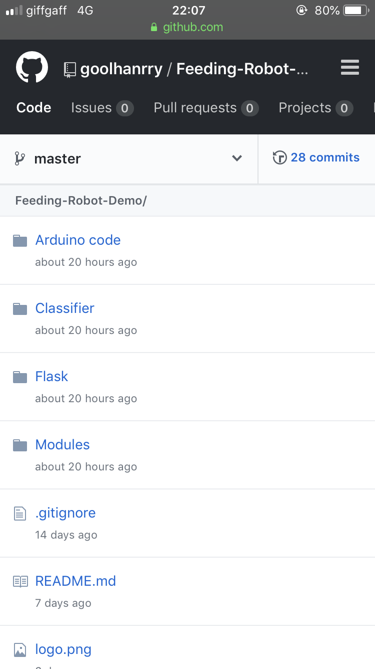
PART 4 TEAMWORK
Information Sharing
Sharing is one of the most important factors contributing to a successful teamwork.
GROUP 4 | Machine Learning, Robotics And Sensor Networks Summer School
08/2018
Notes:
First is sharing. The picture shows that each one of our group uploaded useful resources to our Github repository.

Slide 39
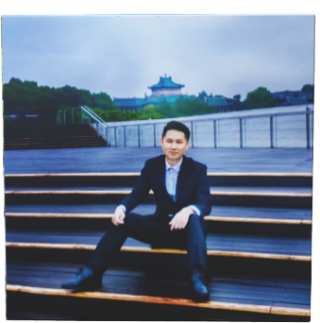
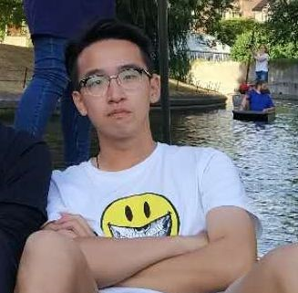
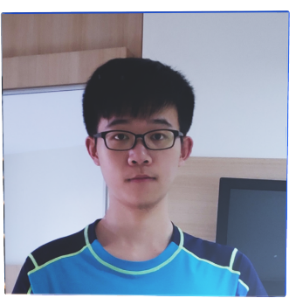
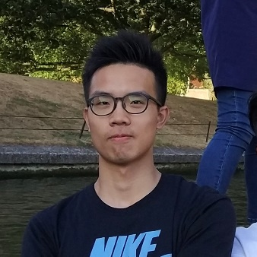
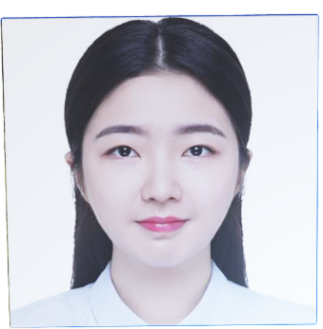
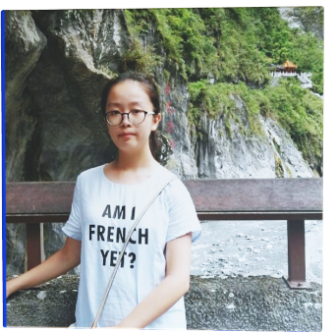
PART 4 TEAMWORK
Everyone has his/her own strengths
ZHENG SIYUAN
WUHAN UNIVERSITY
COMPUTER SCIENCE
2015
HE YUXUAN
WUHAN UNIVERSITY
ELECTRONIC ENGINEERING
2015
WU
YUHUI
HUAZHONG UNIVERSITY of S&T
ELECTRONIC INFORMATION
2015
LIU
YE
WUHAN UNIVERSITY
GEOGRAPHICAL SCIENCE
2016
ZHOU YUXUAN
WUHAN UNIVERSITY
ELECTRONIC ENGINEERING
2016
GU
YING
WUHAN UNIVERSITY
INFORMATION SECURITY
2016
GROUP 4 | Machine Learning, Robotics And Sensor Networks Summer School
08/2018

Slide 40

PART 4 TEAMWORK
Everyone has his/her own strengths
ZHENG
SIYUAN
WUHAN UNIVERSITY
COMPUTER SCIENCE
2015
HE
YUXUAN
WUHAN UNIVERSITY
ELECTRONIC ENGINEERING
2015
Leader, organize meetings to discuss the project, and divide the work.
Have learned a little bit about both hardware and software including python, arduino, etc.,
Main interests: computer vision and machine learning.
Rich project experience
Confident to speak in public, willing to cooperate, approachable
Time keeper, assist in software and hardware, contact supervisors
a)Have experience in computer vision and machine learning
b)Have basic python programming experience
c)have a good command of matlab
d)Good at communication
GROUP 4 | Machine Learning, Robotics And Sensor Networks Summer School
08/2018
Notes:
Second, before dividing the labor, each of us represented our strengths. Zheng Siyuan is an effective leader in our team thanks to his rich project experience. He Yuxuan can communicate fluently so he often consulted supervisors on behave of us.

Slide 41
PART 4 TEAMWORK
Everyone has his/her own strengths
WU
YUHUI
HUAZHONG UNIVERSITY of S&T
ELECTRONIC INFORMATION
2015
LIU
YE
WUHAN UNIVERSITY
GEOGRAPHICAL SCIENCE
2016
Chief hardware director
a)Strong ability in handwork
b)Careful and calm
c)Have basic knowledge about machine
Chief software programmer, assist in hardware
a)Have experience in machine learning and web framework
b)Strong ability in coding, wrote all the code for the project
c)Proficient in Python, JavaScript, C++, Matlab, etc.
d)Able to work out various algorithms to realize certain expectations
GROUP 4 | Machine Learning, Robotics And Sensor Networks Summer School
08/2018
Notes:
Wu Yuhui is good at hardware so he always fixed the fragile arm every time it broke down.
Liu Ye has a strong ability in coding so he wrote most of the codes in our project.

Slide 42
PART 4 TEAMWORK
Everyone has his/her own strengths
ZHOU
YUXUAN
WUHAN UNIVERSITY
ELECTRONIC ENGINEERING
2016
GU
YING
WUHAN UNIVERSITY
INFORMATION SECURITY
2016
Business planner, paperwork, responsible for safety
a)Minor in Finance, have basic knowledge about marketing
b)Good at English writing
Business planner, PPT designer
a)Have a good command of Ps, PowerPoint and relative presentation tools
b)Good at English writing
GROUP 4 | Machine Learning, Robotics And Sensor Networks Summer School
08/2018
Notes:
Gu Ying and I are not so experienced in hardware and software, so we focused our work on paperwork and multimedia as well as business plan. But we also learned the basic knowledge of the project and helped with the running of the codes, which was quite helpful to us.

Slide 43
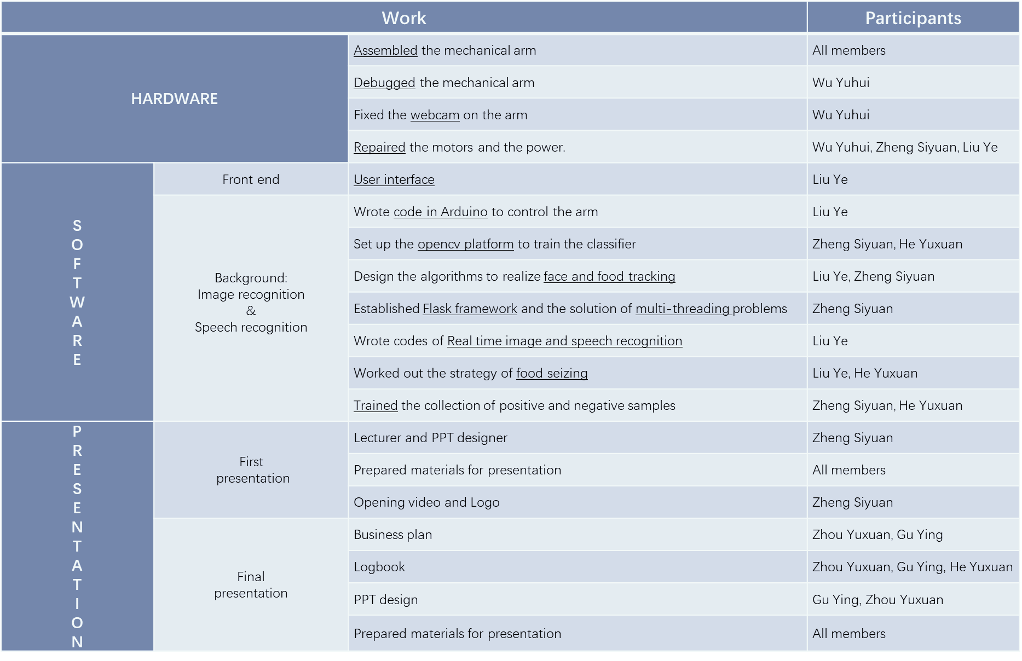
PART 4 TEAMWORK
Everyone makes a difference
Notes:
. For the sake of time I won’t elaborate on all of work we did, but I made a table which basically covers our work in the project. As you can see, everyone made the most of their advantages with the help of others.

Slide 44
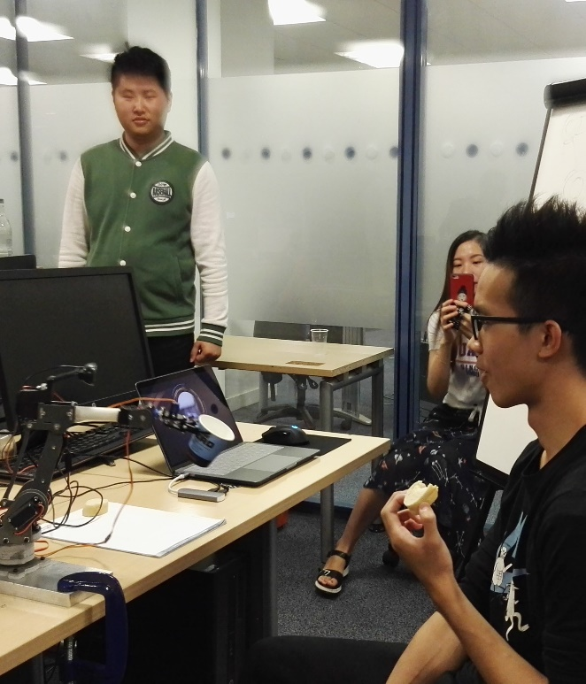
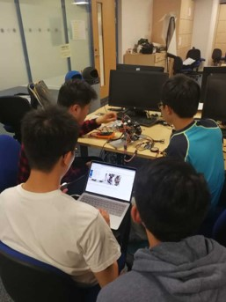
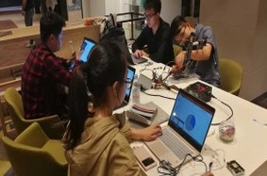
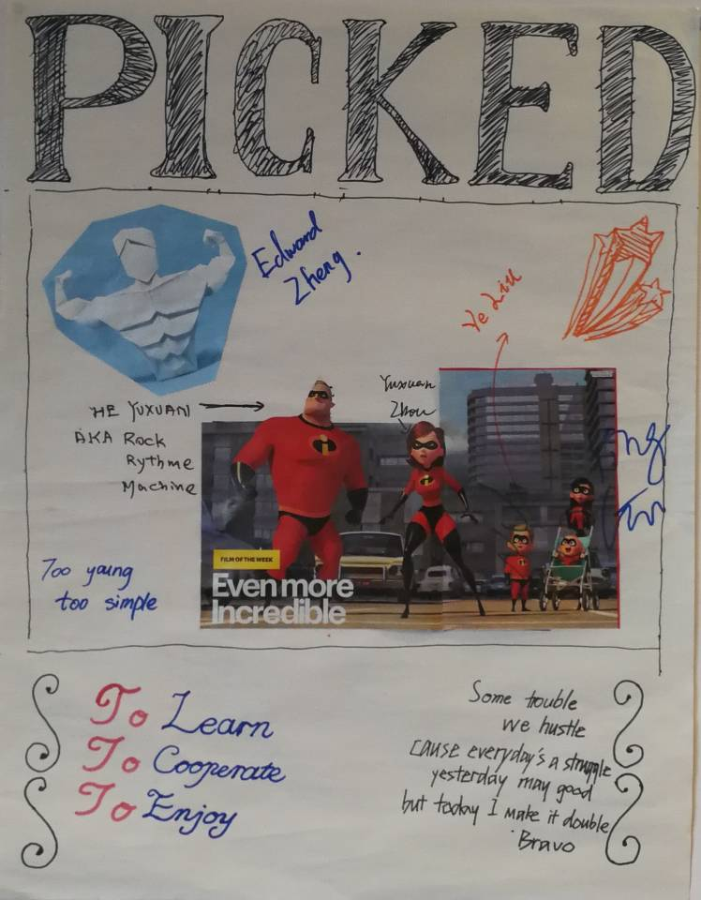
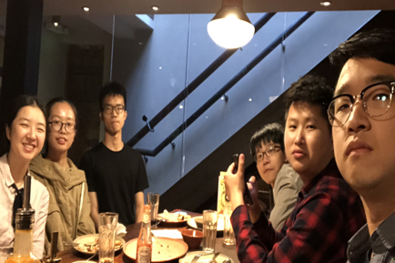
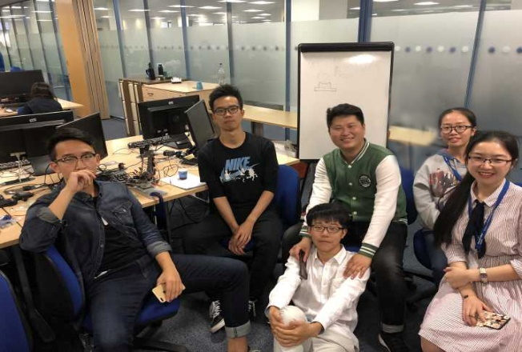
PART 4 TEAMWORK
Enjoy time together
GROUP 4 | Machine Learning, Robotics And Sensor Networks Summer School
08/2018
Notes:
Finally, I want to express my gratitude to our group. In a month, from strangers to teammates and finally friends, we discussed the project together, overcame difficulties together, and had fun together. We had a great time together.

Slide 45

Thank You For Watching
GROUP 4 | 08/2018

